Slide 1
Devops

Slide 2
Traditional Approaches

Slide 3
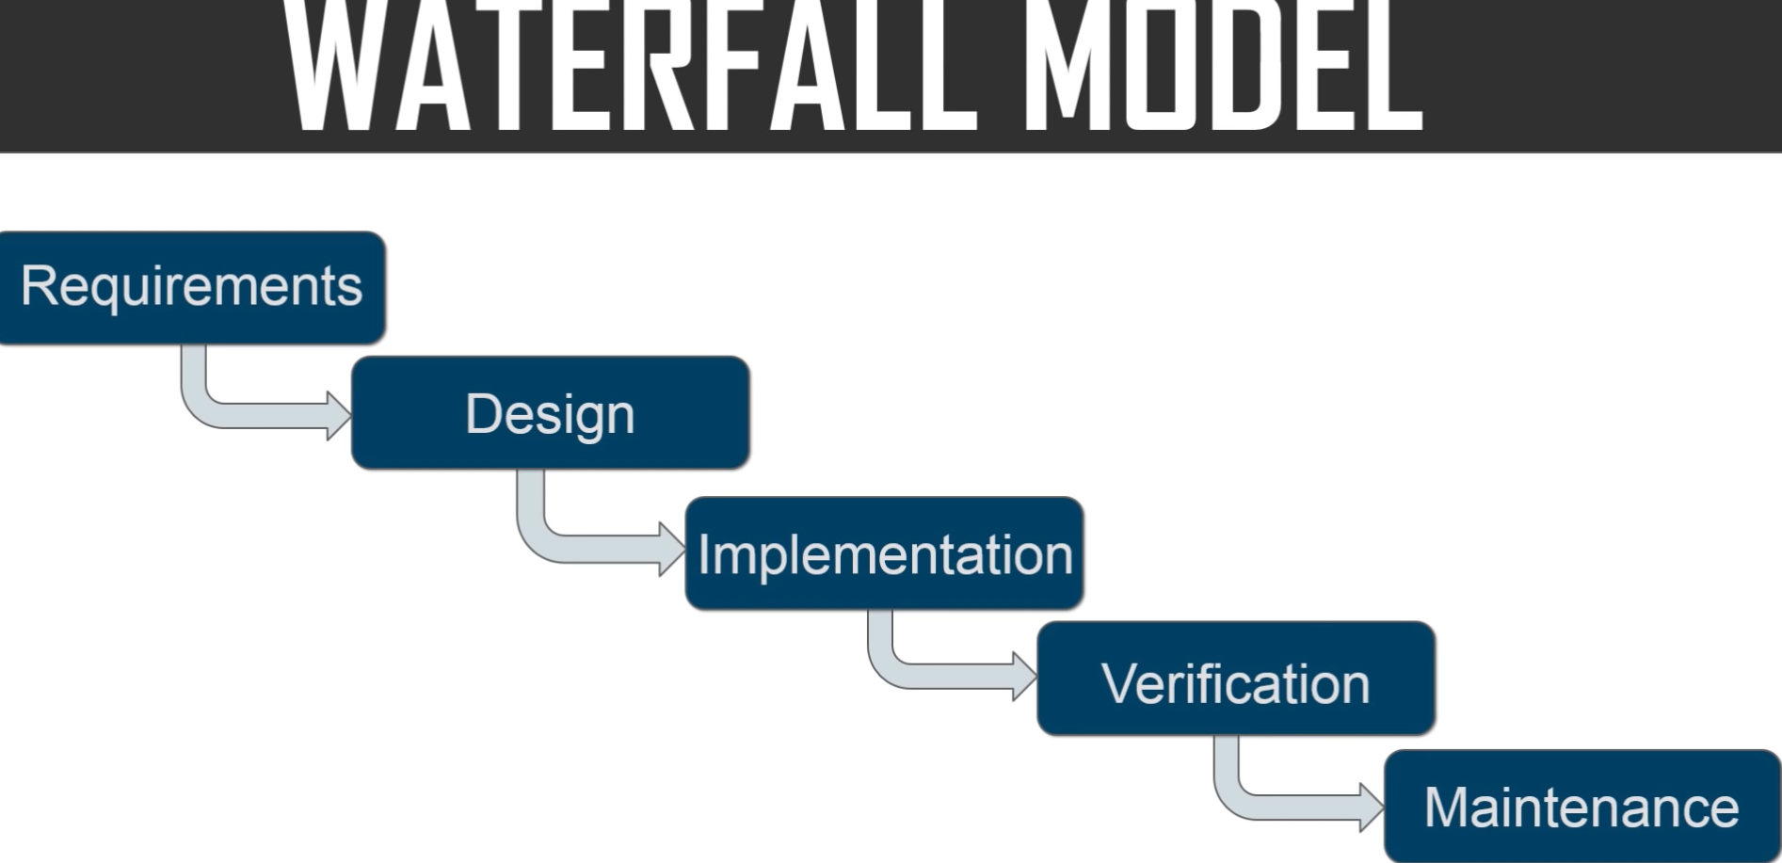

Slide 4
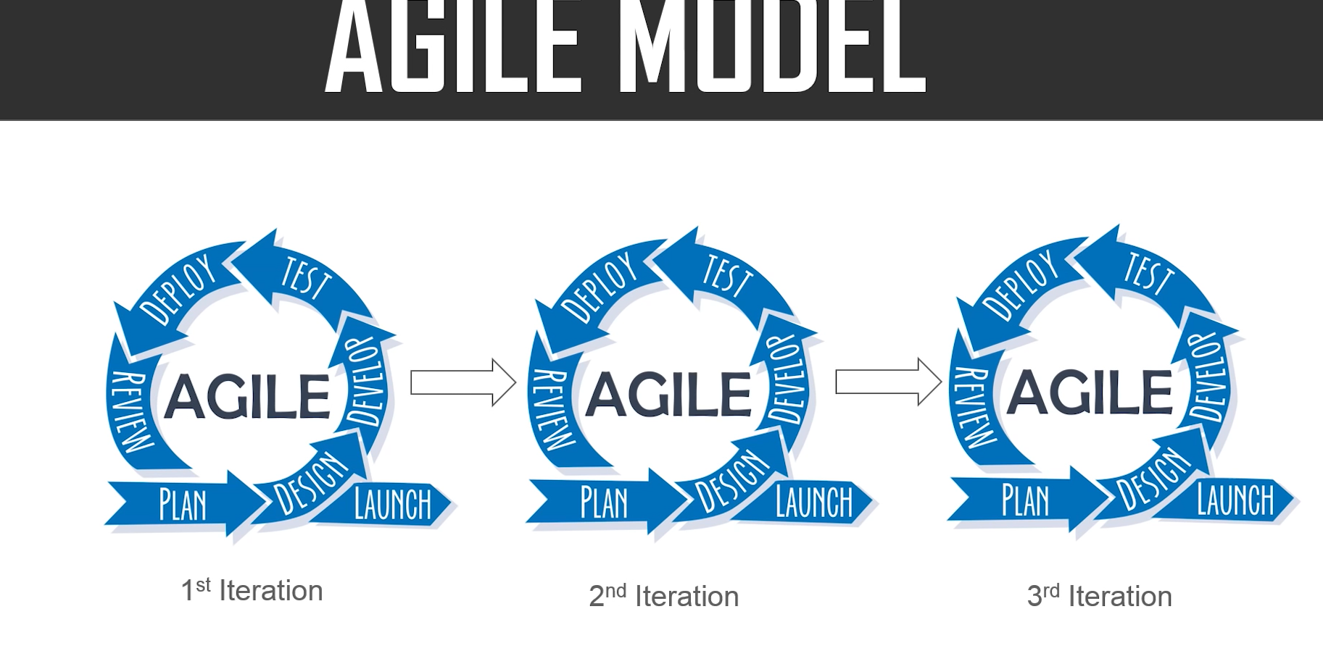

Slide 5
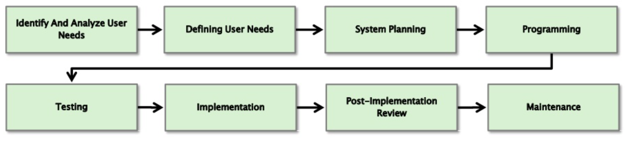

Slide 6
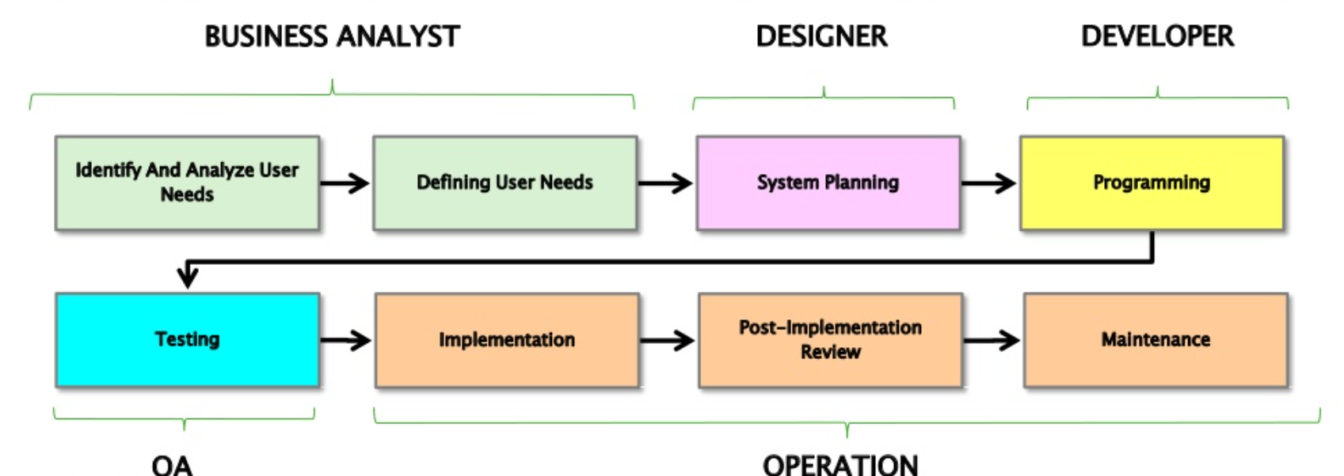

Slide 7
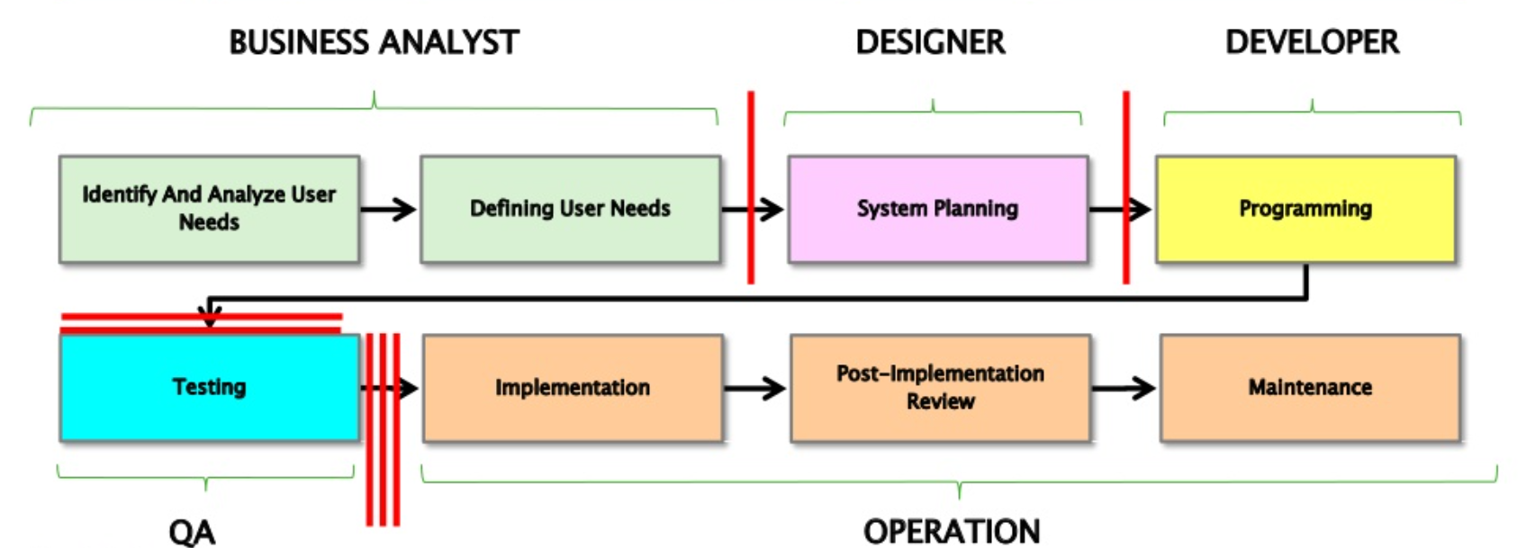

Slide 8
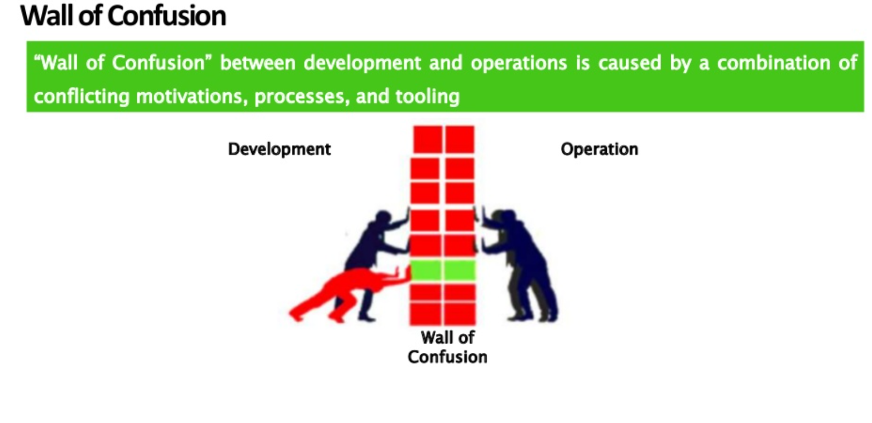

Slide 9
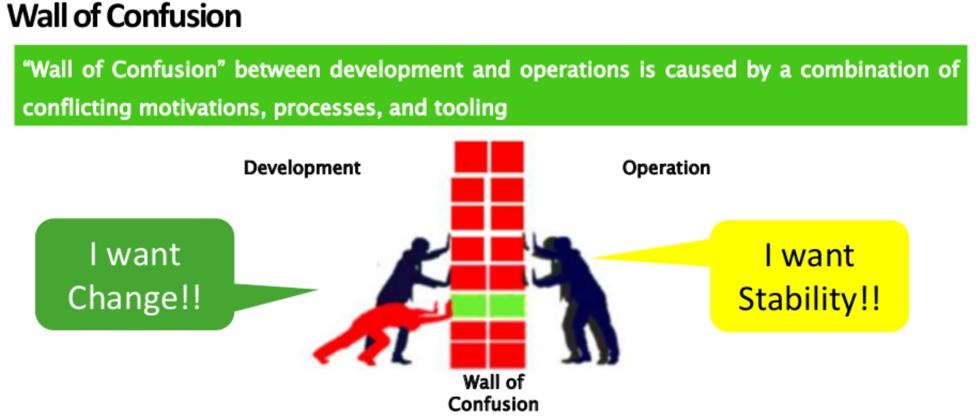

Slide 10


Slide 11
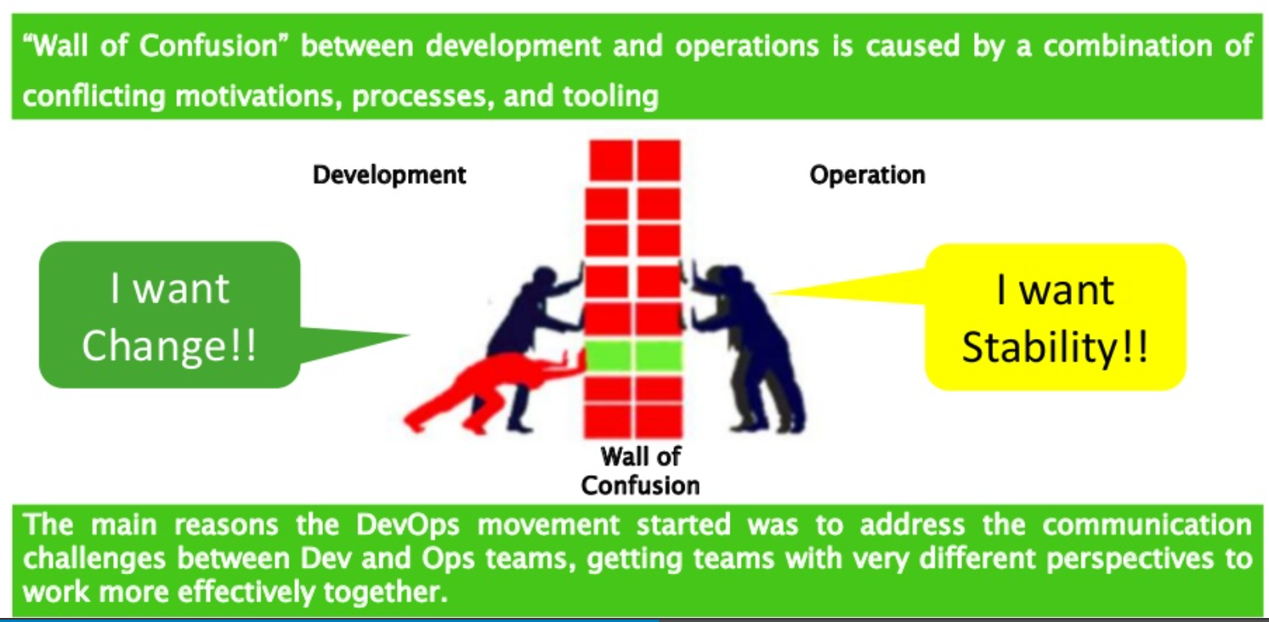

Slide 12


Slide 13
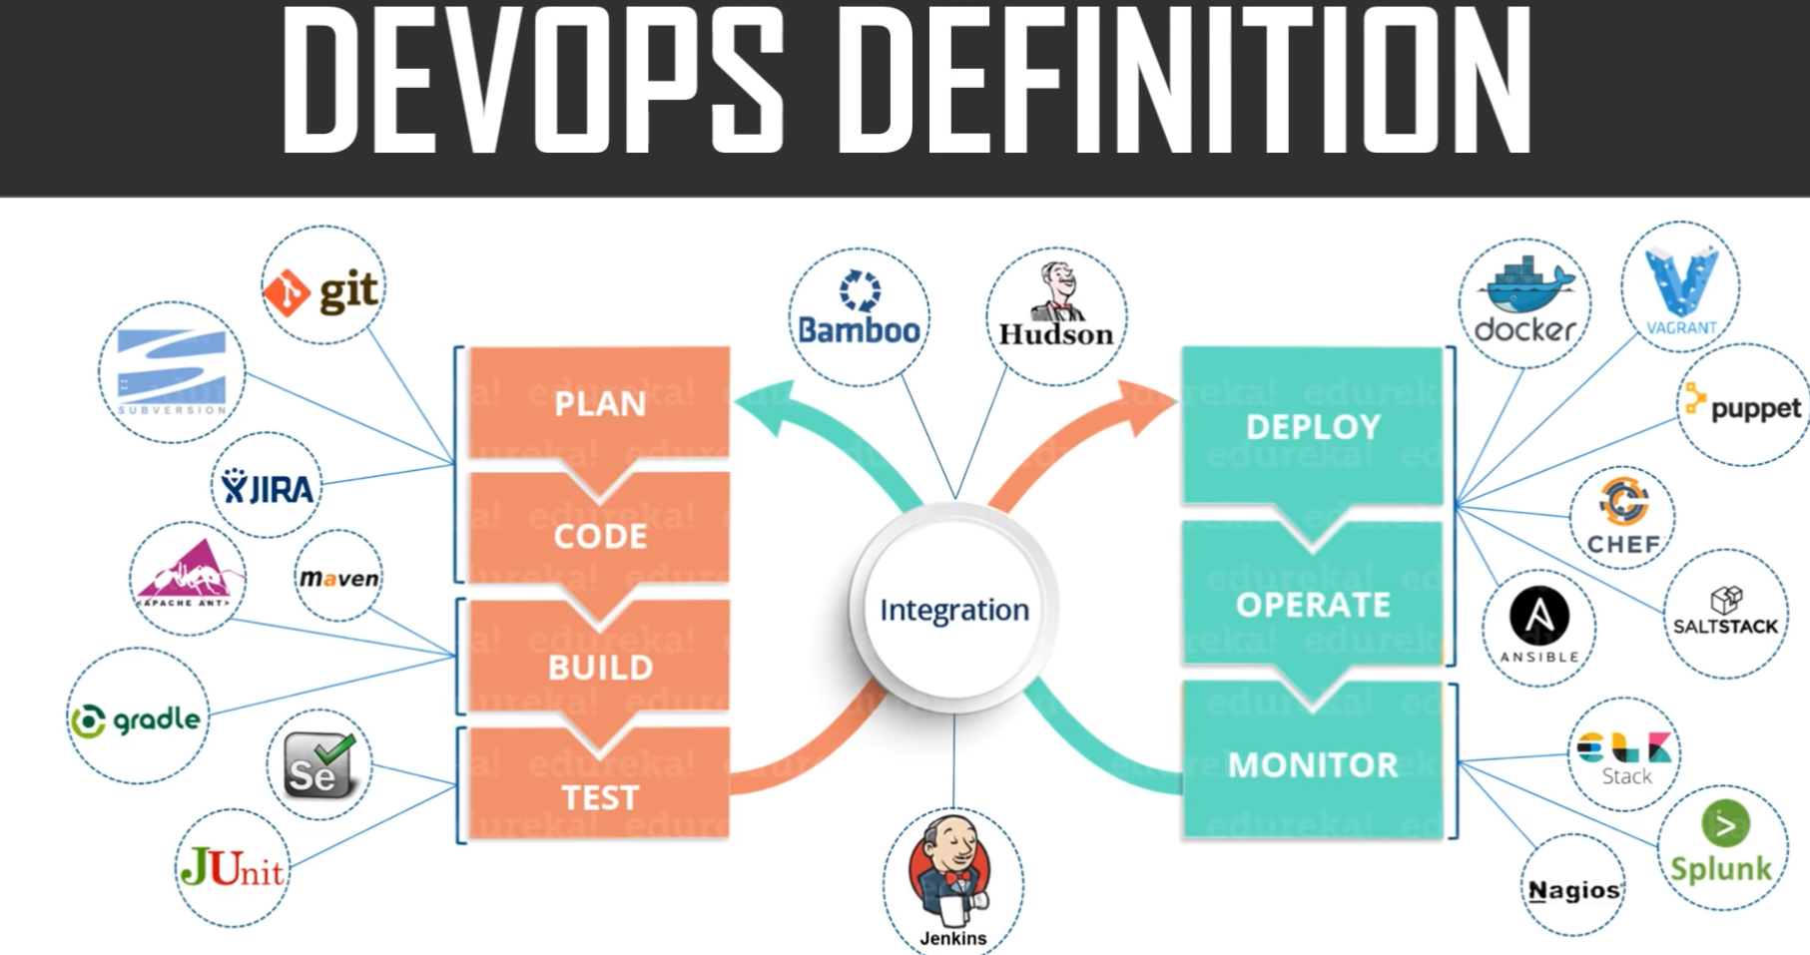

Slide 14
What is DevOps?
DevOps is a collaboration between Development and IT Operations to make software production and deployment in an automated & repeatable way. DevOps helps to increase the organization's speed to deliver software applications and services. The word 'DevOps' is a combination of two words, 'Development' and 'Operations.’
It allows organizations to serve their customers better and compete more strongly in the market. In simple words, DevOps can be defined as an alignment of development and IT operations with better communication and collaboration.

Slide 15
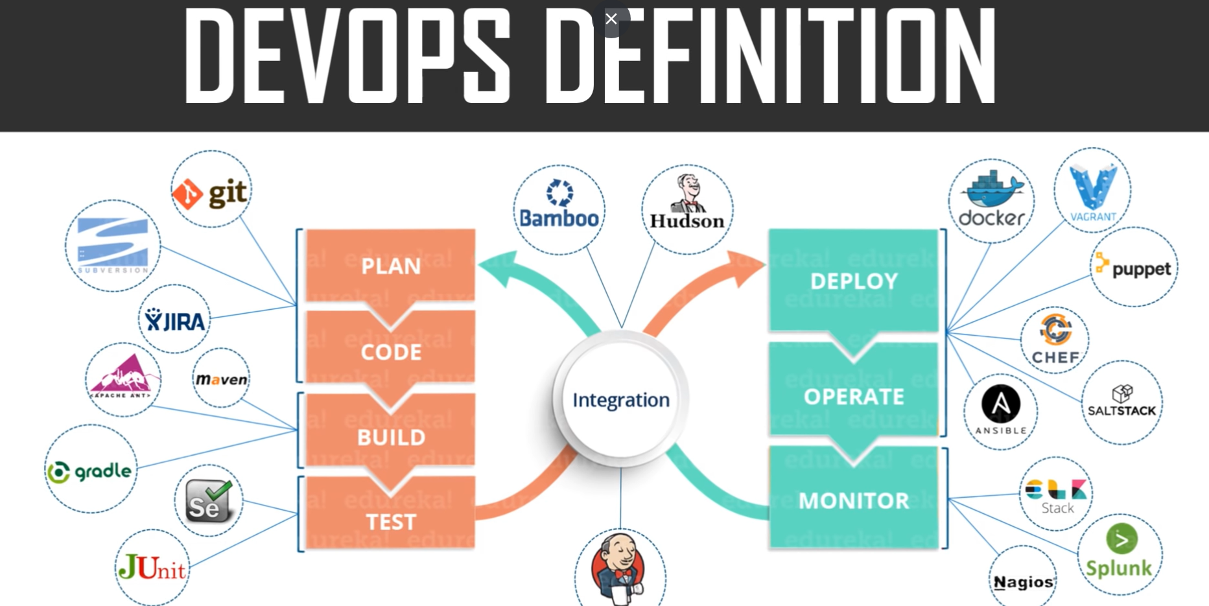

Slide 16


Slide 17
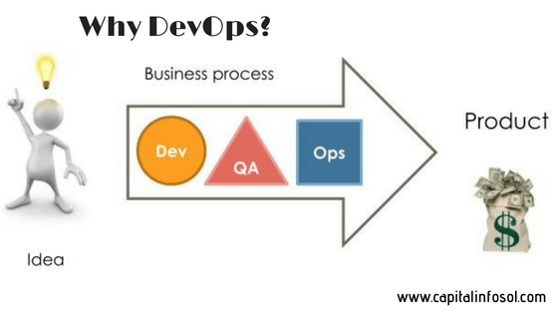

Slide 18
Before DevOps, the development and operation team worked in complete isolation.
Testing and Deployment were isolated activities done after design-build. Hence they consumed more time than actual build cycles.
Without using DevOps, team members are spending a large amount of their time in testing, deploying, and designing instead of building the project.
Manual code deployment leads to human errors in production
Coding & operation teams have their separate timelines and are not in synch causing further delays.

Slide 19
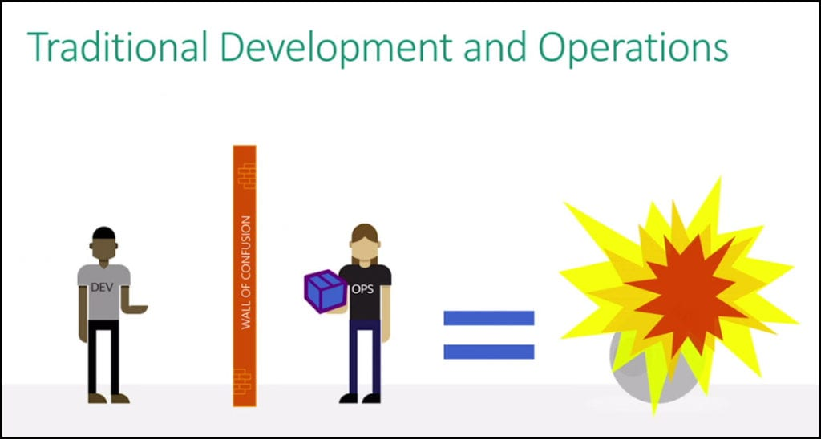
How is DevOps different from traditional IT

Slide 20
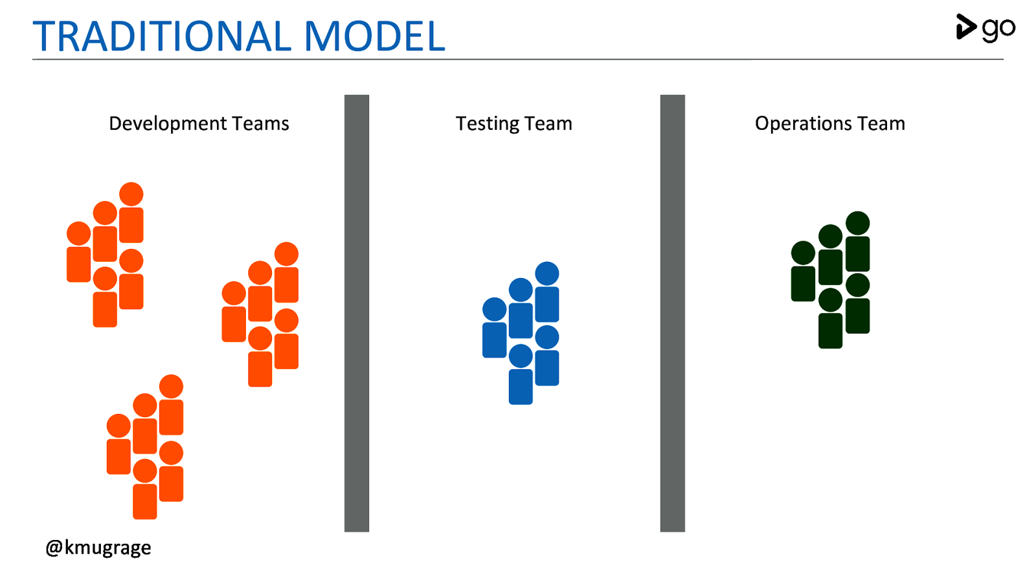

Slide 21
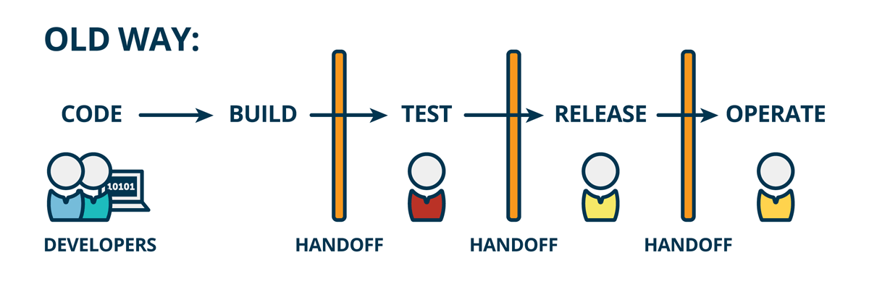

Slide 22
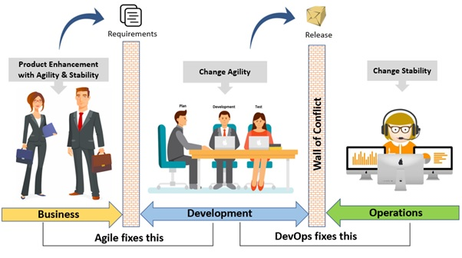

Slide 23
Why is DevOps used?
DevOps allows Agile Development Teams to implement Continuous Integration and Continuous Delivery. This helps them to launch products faster into the market.
Other Important reasons are:
1. Predictability: DevOps offers significantly lower failure rate of new releases
2. Reproducibility: Version everything so that earlier version can be restored anytime.
3. Maintainability: Effortless process of recovery in the event of a new release crashing or disabling the current system.
4. Time to market: DevOps reduces the time to market up to 50% through streamlined software delivery. This is particularly the case for digital and mobile applications.

Slide 24
5. Greater Quality: DevOps helps the team to provide improved quality of application development as it incorporates infrastructure issues.
6. Reduced Risk: DevOps incorporates security aspects in the software delivery lifecycle. It helps in reduction of defects across the lifecycle.
7. Resiliency: The Operational state of the software system is more stable, secure, and changes are auditable.
8. Cost Efficiency: DevOps offers cost efficiency in the software development process which is always an aspiration of IT companies' management.
9. Breaks larger code base into small pieces: DevOps is based on the agile programming method. Therefore, it allows breaking larger code bases into smaller and manageable chunks.

Slide 25
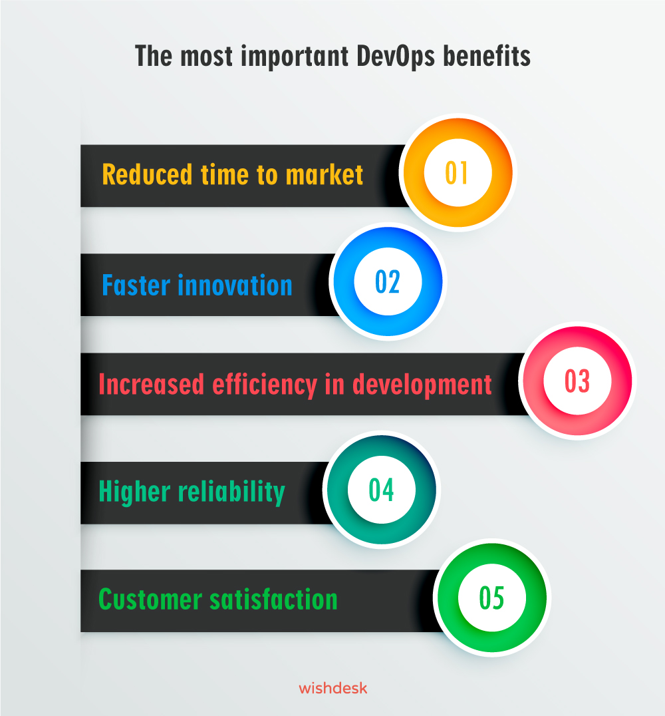

Slide 26
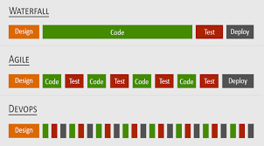

Slide 27
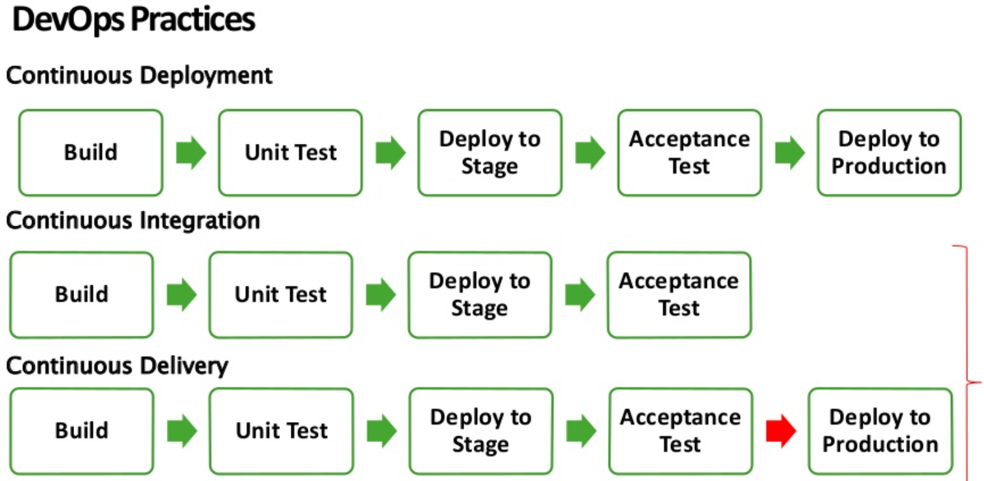

Slide 28
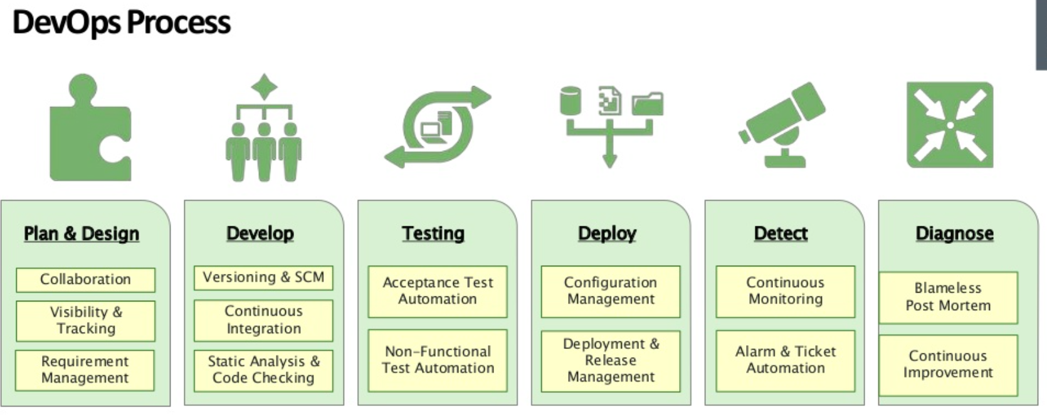

Slide 29
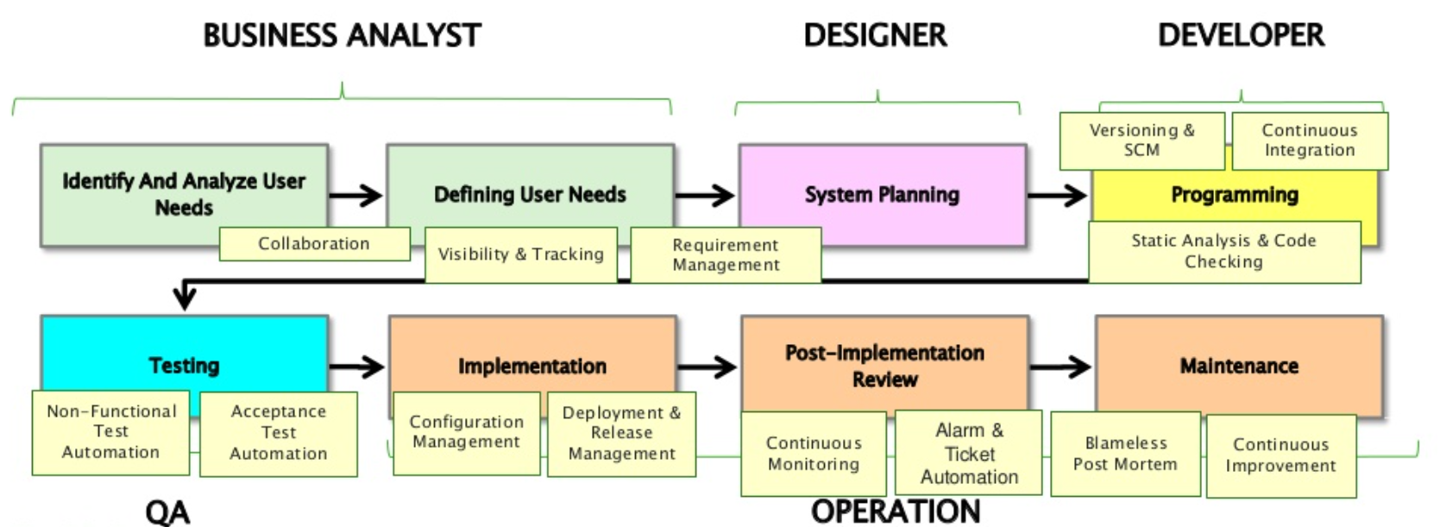

Slide 30
When to adopt DevOps?
DevOps should be used for large distributed applications such as eCommerce sites or applications hosted on a cloud platform.

Slide 31
When not to adopt DevOps?
It should not be used in a mission-critical application like bank, power and other sensitive data sites. Such applications need strict access controls on the production environment, a detailed change management policy, access control policy to the data centers.

Slide 32
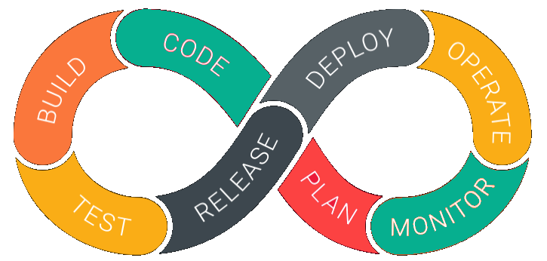
DevOps Lifecycle

Slide 33

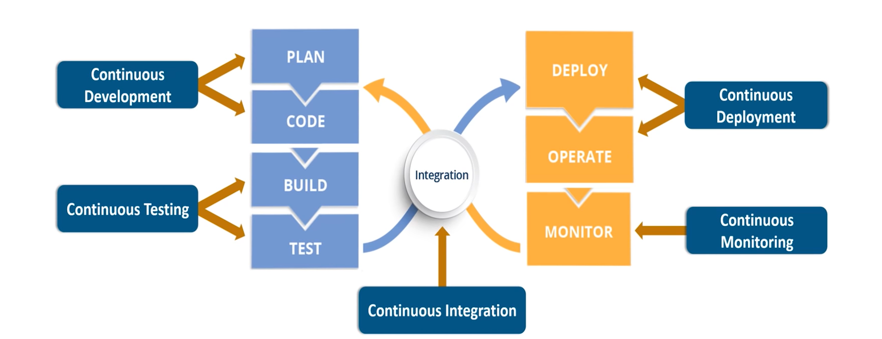

Slide 34
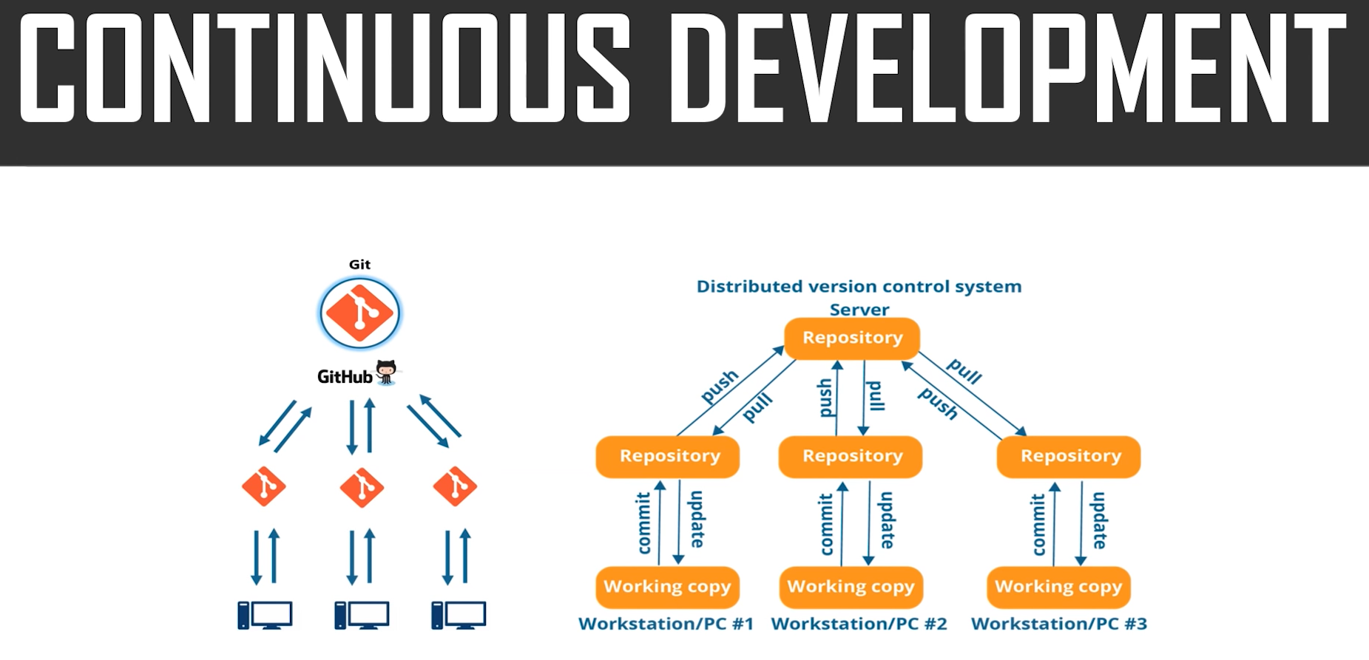

Slide 35
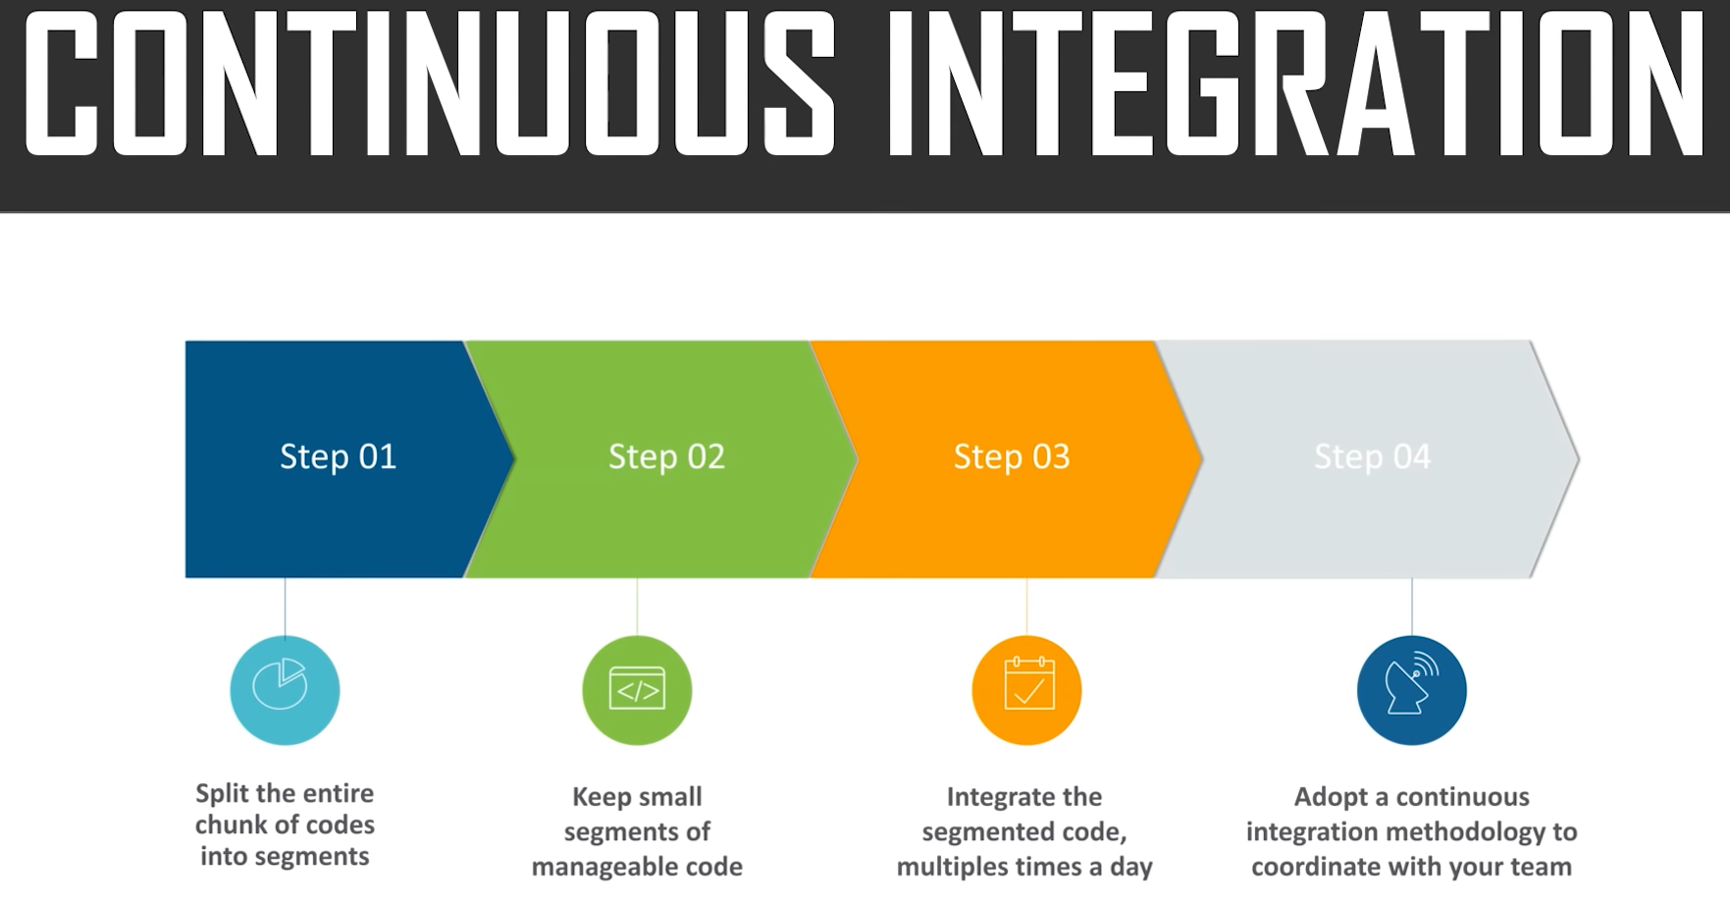

Slide 36
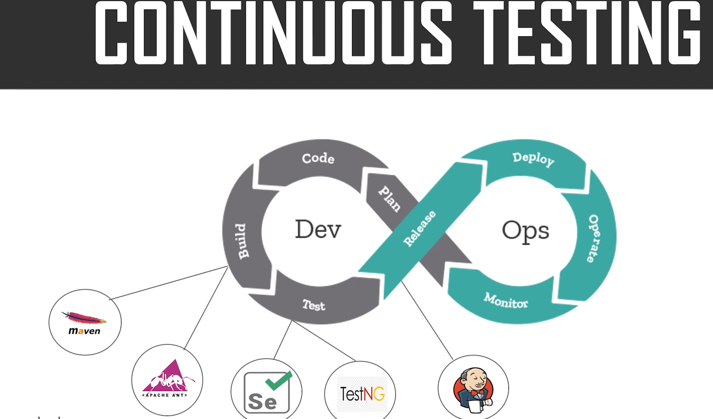

Slide 37
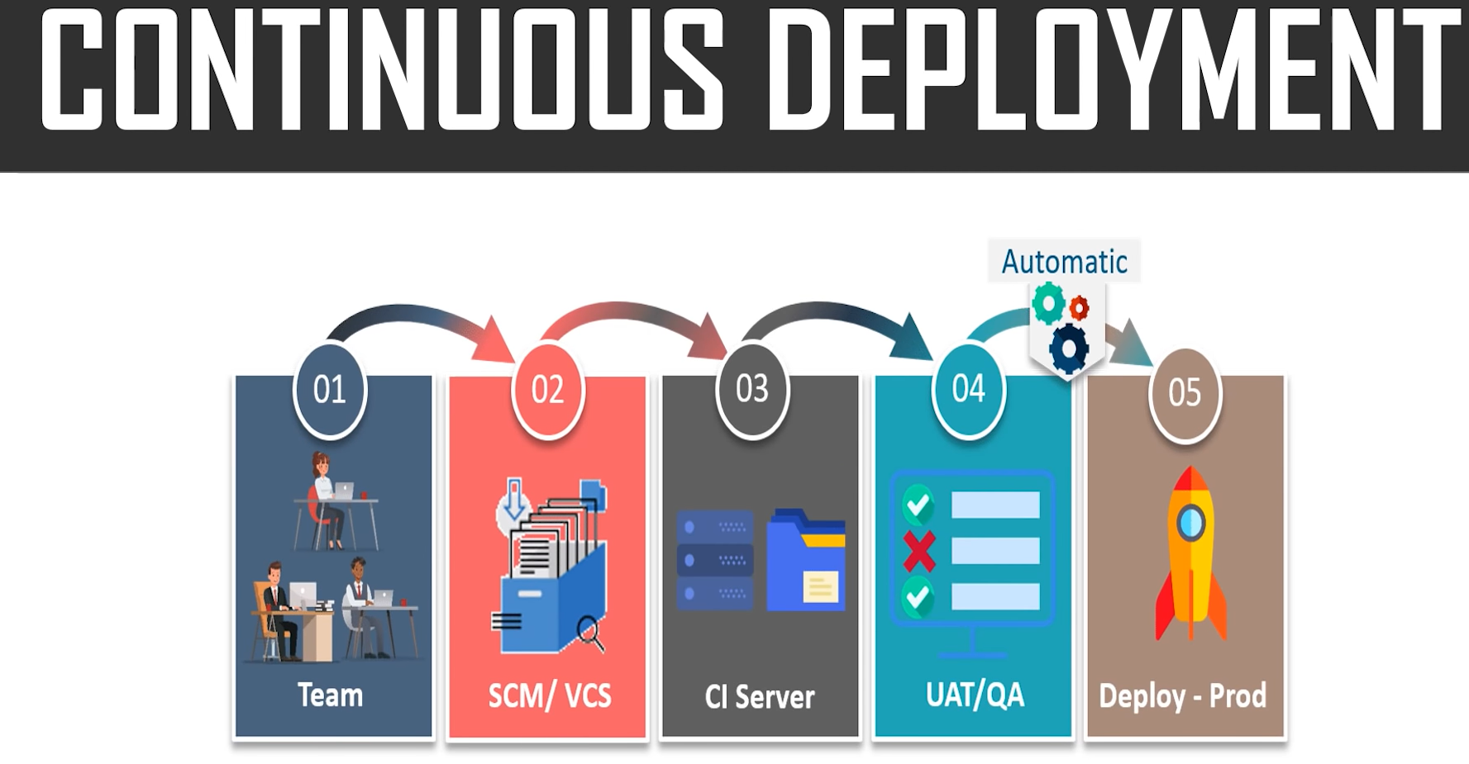

Slide 38
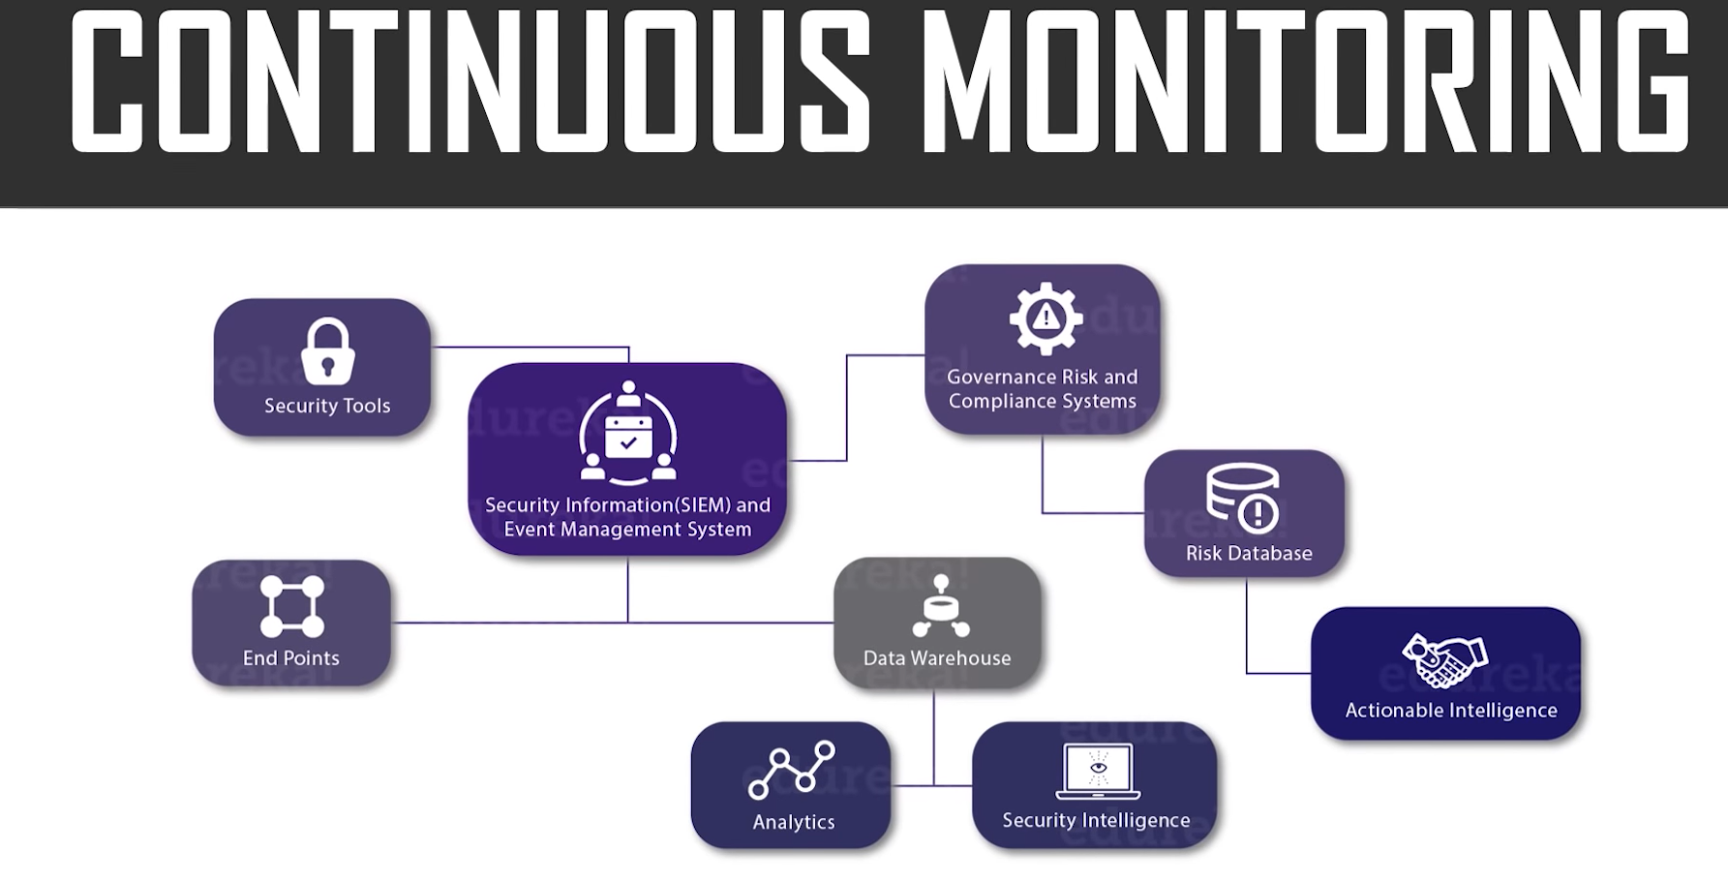

Slide 39
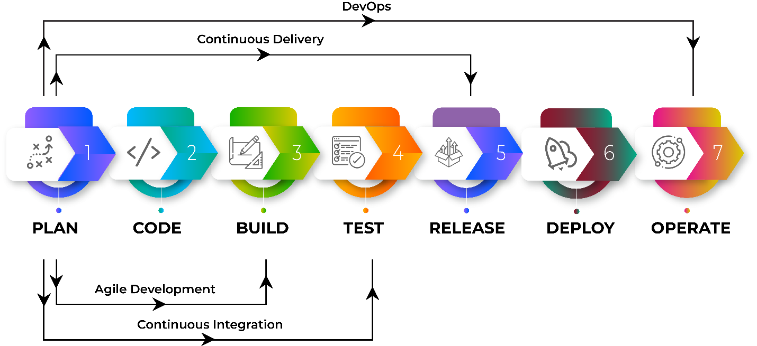

Slide 40
DevOps Lifecycle
1. Development
In this DevOps stage the development of software takes place constantly. In this phase, the entire development process is separated into small development cycles. This benefits DevOps team to speed up software development and delivery process.
2. Testing
QA team use tools like Selenium to identify and fix bugs in the new piece of code.

Slide 41
DevOps Lifecycle
3. Integration
In this stage, new functionality is integrated with the prevailing code, and testing takes place. Continuous development is only possible due to continuous integration and testing.
4. Deployment
In this phase, the deployment process takes place continuously. It is performed in such a manner that any changes made any time in the code, should not affect the functioning of high traffic website.

Slide 42
DevOps Lifecycle
5. Monitoring
In this phase, operation team will take care of the inappropriate system behavior or bugs which are found in production.

Slide 43
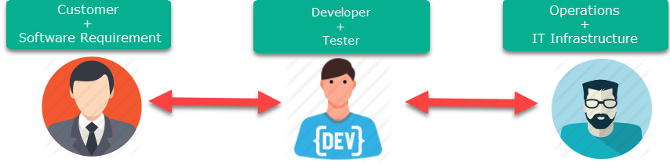
How is DevOps different from Agile? DevOps Vs Agile
Stakeholders and communication chain a typical IT process.

Slide 44
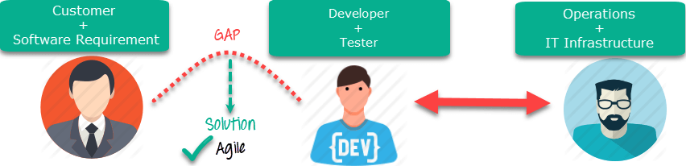
Agile addresses gaps in Customer and Developer communications

Slide 45
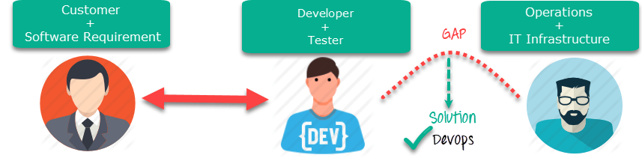
DevOps addresses gaps in Developer and IT Operations communications

Slide 46
Who is a DevOps Engineer?
A DevOps Engineer is an IT professional who works with software developers, system operators, and other production IT staff to administer code releases. DevOps should have hard as well as soft skills to communicate and collaborate with development, testing, and operations teams.
DevOps approach needs frequent, incremental changes to code versions, which means frequent deployment and testing regimens. Although DevOps engineers need to code occasionally from scratch, it is important that they should have the basics of software development languages.
A DevOps engineer will work with development team staff to tackle the coding and scripting needed to connect elements of code, like libraries or software development kits.

Slide 47
Roles, Responsibilities, and Skills of a DevOps Engineer
hey are responsible for the production and ongoing maintenance of a software application's platform.
Following are some expected Roles, Responsibilities, and Skills that is expected from DevOps engineer:
Able to perform system troubleshooting and problem-solving across platform and application domains.
Manage project effectively through open, standards-based platforms
Increase project visibility thought traceability

Slide 48
Improve quality and reduce development cost with collaboration
Analyse, design and evaluate automation scripts & systems
Ensuring critical resolution of system issues by using the best cloud security solutions services
DevOps engineer should have the soft skill of problem-solver and quick-learner

